Slide 1
Fossil Fuels
Jason, Jesus, John

Slide 2
Advantages
Cheap
High power output
Reliable
Global distribution
Generates thousands of jobs
Easily available

Slide 3
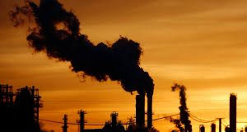
Disadvantages
Finite resource
Emits greenhouse gases
Negative impact on human health
Negative environmental impact
Dangerous accidents

Slide 4
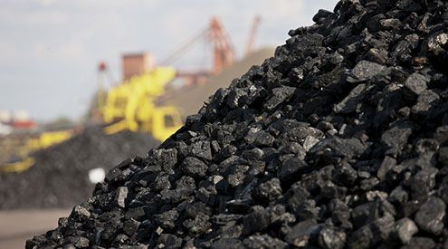
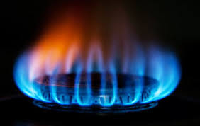
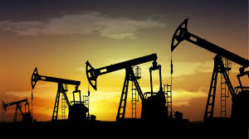
Types of Primary Sources
Coal
Oil/petroleum
Natural gas

Slide 5
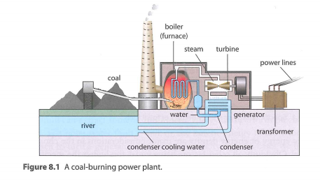
Processing the Power
Fossil fuels are burned to produce energy so that water can turn into steam for the boilers. The stream forces the turbine to turn. The turbine makes the coils of the generator rotate to make electricity. Cold water from river or other water sources helps condenses the steam into liquid, so that the process can be redone.

Slide 6
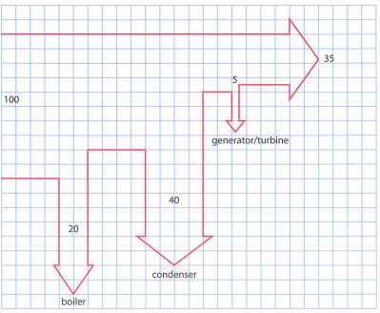
Sankey Diagram

Slide 7
How to Solve
Power output: P = (E_{s} x kg x e) / (24 x 60 x 60) where E_{s} is the specific energy of the fuel in joules, kg is the amount of fuel in kilograms, and e is the efficiency in decimal form
Rate energy is discarded at: P_{discarded} = [(1 - e) x E_{s} x kg] / (24 x 60 x 60)
Rate of water flowing away = P_{discarded} / c_{s}
Kilometers per liter of gas: d = {[(34 x 10⁶ J) x e] / kw} x s where kW is the power developed by the engine in kilowatts, s is the speed of the vehicle in meters per second, and d is the distance in meters
Amount of fuel burned in a day: [(GW x 24 x 60 x 60) / 0.4] / E_{s} where GW is the number of GW a power plant produces converted to joules per kilogram

Slide 8
More Information
If fossil fuels continue to be used at the rate that they are being used then the pollution will make global warming even more of a concern. The resources that we are currently using are running out, we are using more than th planet is producing so we will run out eventually if we don't cut back on our usage.

Slide 9
Sources
https://greentumble.com/pros-and-cons-of-fossil-fuels/
https://ourworldindata.org/fossil-fuels
https://www.renewableenergysolar.net/solar/fossil-fuels-their-effect-on-the-environment/

